Slide 1
How to use
“BIRDS-4 CW decoder”
Daisuke Nakayama
2021/3/11
for software v1.1

Slide 2
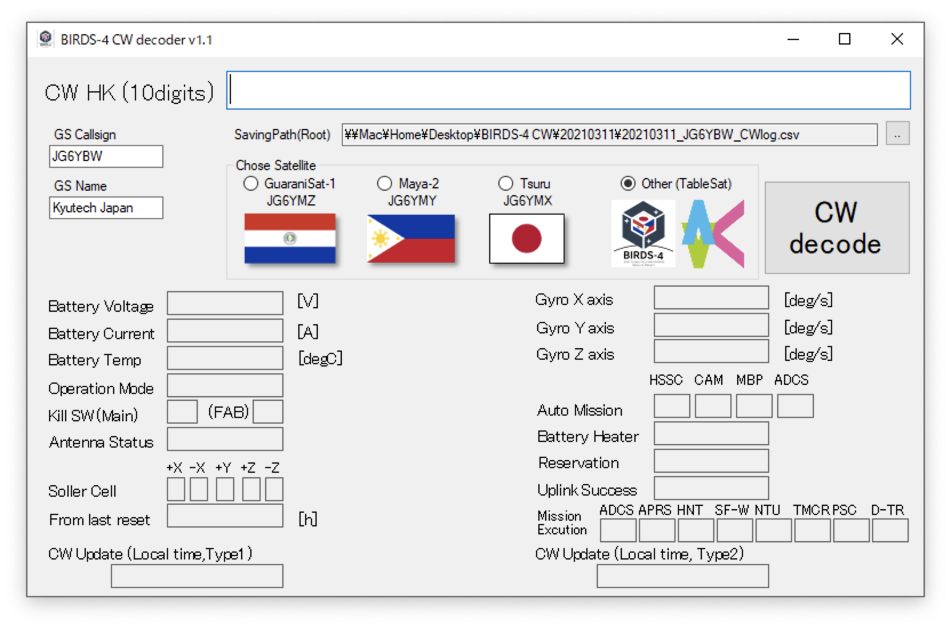
Initial setting
Put your callsign
Select saving path
They are saved in decoder
“GS Name” is optional
1. Callsign
2. Path

Slide 3
When you receive CW beacon 1
Select the Satellite
Input last 10 digits of CW beacon.
  e.g. 000000f987
  e.g. a697756408
Click ”CW decode” button
It’s saved in csv file.
Saving CSV filename
  “[Selected path]¥yyyymmdd¥yyyymmdd_[callsign]_CWlog.csv”
  yyyy : year (e.g. 2021) , mm : month (e.g. 03), dd : day(e.g. 11)

Slide 4
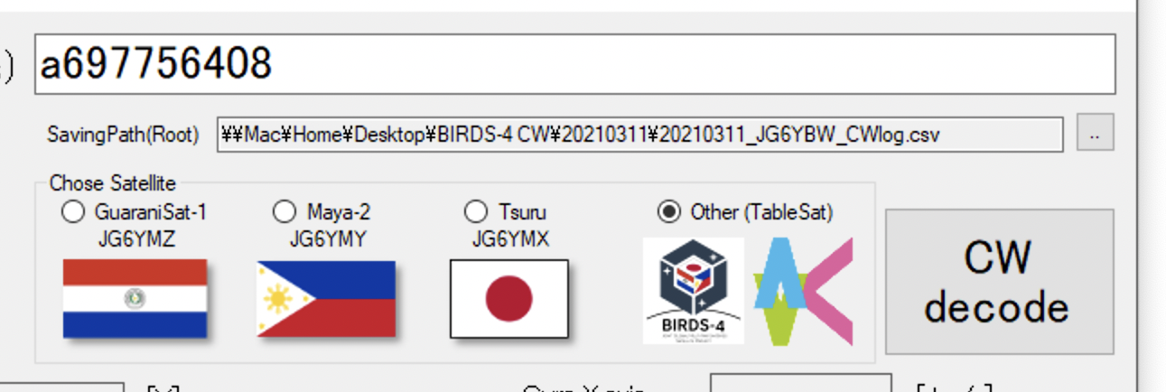

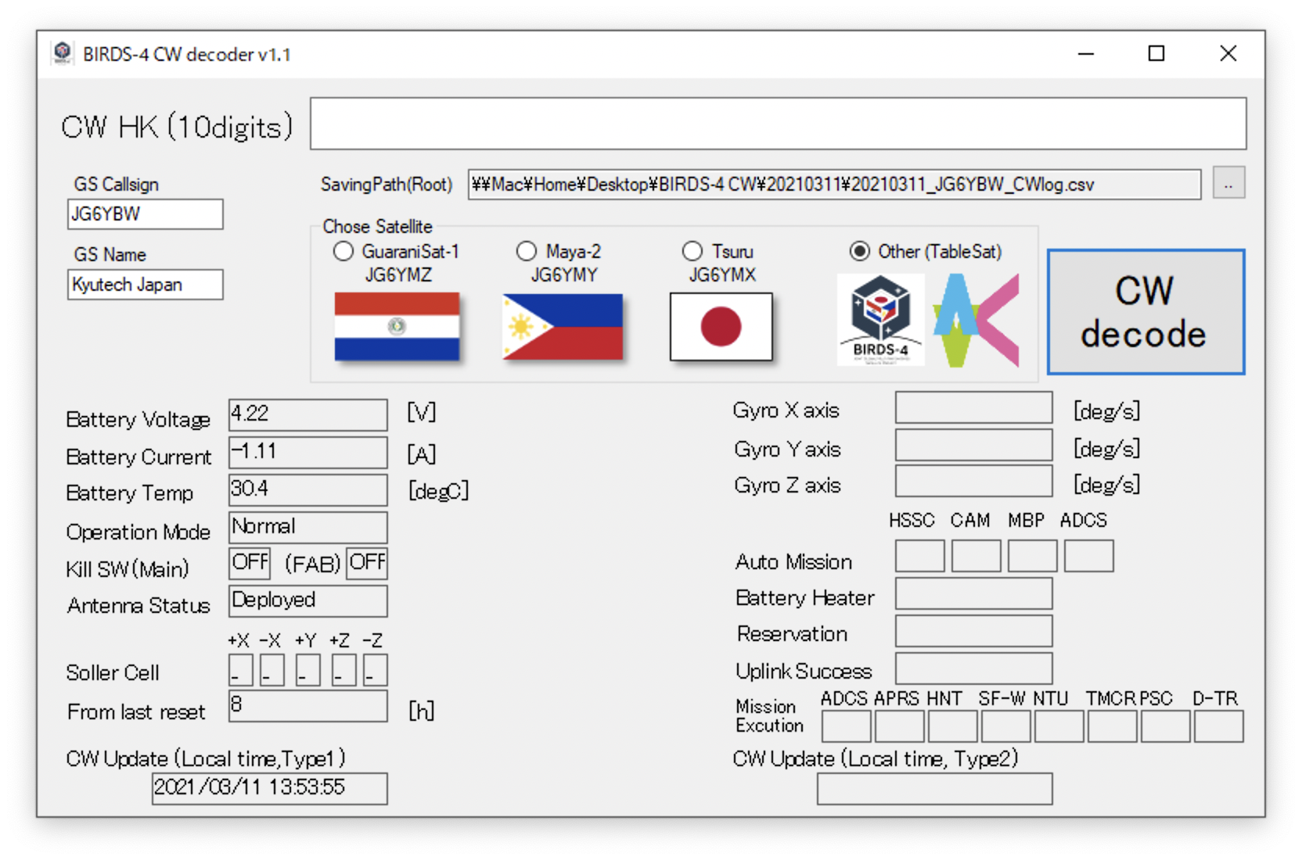
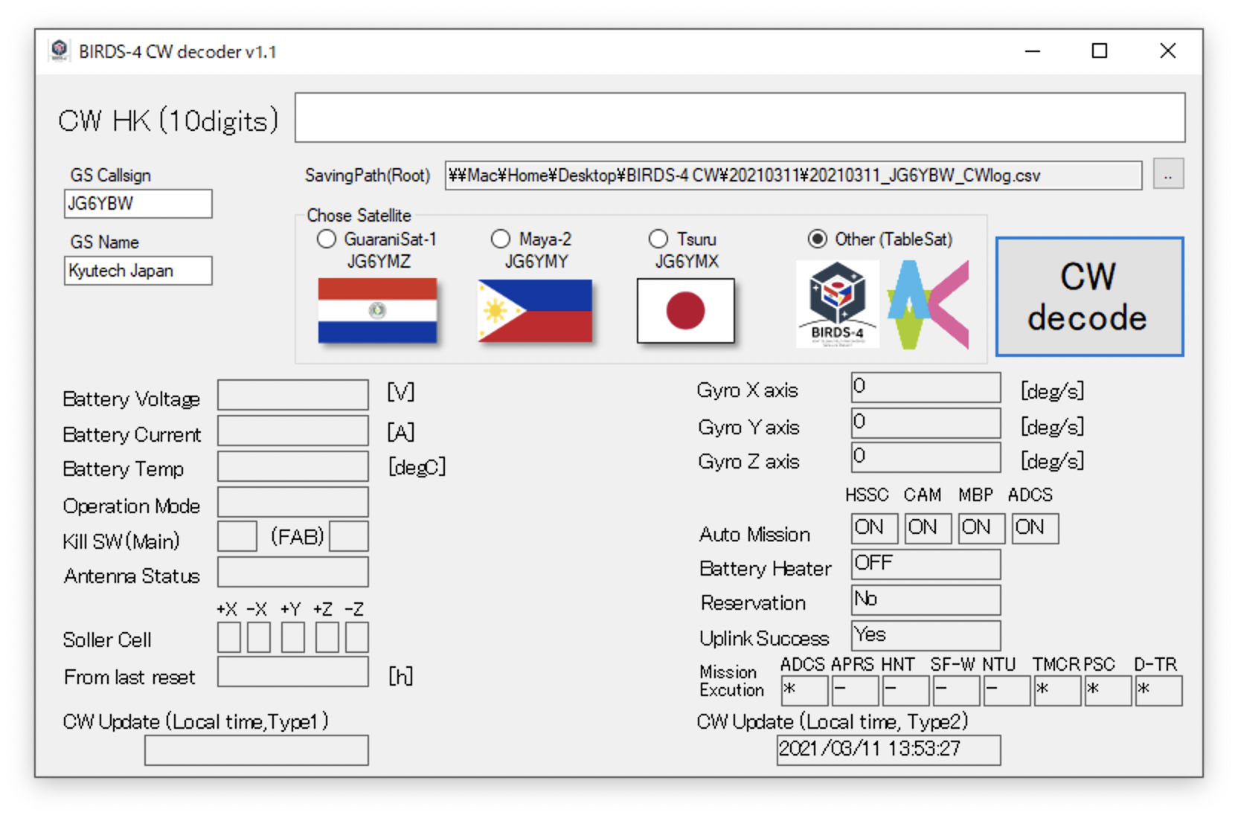
When you receive CW beacon 2
Decoded data is shown
  There are 2 types of CW message.
Input CW type 1
Input CW type 2
Click this button
Click this button
The left value is updated
and saved in csv file
The right value is updated
and saved in csv file

Slide 5
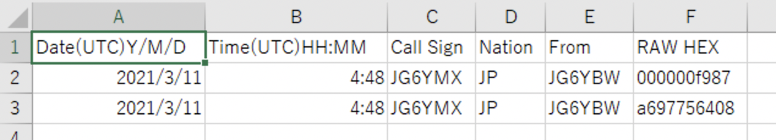
After clicking
CSV file is saved.
Time, callsign and CW data are contained.
Please submit this CSV file in our website.
Thank you for your cooperation!

